Slide 1
SAMI
RSI
Difficult airway
CICV
On-line Tutorial
Anticipation

Slide 2
Introduction
RSI
The purpose of this course is to improve the skills of the team involved in managing the airway of intensive care patients.
In March 2011 the 4th National Audit program (which can be found here) found that a disproportionate number of reported airway events occurred on Intensive Care Units (ICUs). The reasons it highlighted for this included a lack of; skilled staff, planning, appropriate equipment and appropriate responses to unfolding events. 58% of events were felt to have been caused, or contributed to, by education and training.
This on-line material covers the theory needed to manage the airway on ICU.
Difficult airway
CICV
Anticipation

Slide 3
Introduction
RSI
The on-line material is divided into 4 sections. At the beginning of each section there is a summary of what it will cover and the learning outcomes.
As everyone has a different background, some people may be very familiar with this material, whereas for others it may be revision or even novel.
Although some of the material covered here will be revisited on the day there will be no lectures. To make the most of the day please make sure you are happy with the learning outcomes from each section.
Its up to you to decide which of the sections you need to
visit!
Difficult airway
CICV
Anticipation

Slide 4
Navigation
RSI
There is a navigation button at the bottom right hand corner of each page. , or . Click on this once you have finished each page.
There is also a navigation bar at the right side of each page. The beginning of each section can be accessed by clicking on the corresponding button, and clicking on the home button at the bottom will take you back to the contents page.
In some places there are information buttons clicking on these will provide you with further information.
Difficult airway
CICV
Anticipation

Slide 5
Contents
RSI
Difficult airway
Rapid sequence induction (RSI)
CICV
Difficult airway
Can’t intubate, can’t ventilate (CICV)
Anticipation
Anticipating a difficult airway

Slide 6
Rapid Sequence Induction
RSI
Difficult airway
CICV
On-line Tutorial
Anticipation

Slide 7
Summary
RSI
This section covers how to perform a rapid sequence induction (RSI).
Learning Outcomes
Understand what a RSI is
Understand why a RSI is commonly used in ICU patients
Know what is involved in performing a RSI including
The B@EASE algorithm
The equipment used
The drugs involved
Difficult airway
CICV
Anticipation

Slide 8
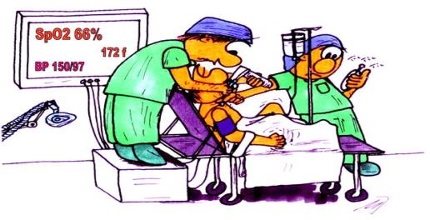
Contents
RSI
What is RSI?
Why do we do it?
What do we do?
Risks
Difficult airway
CICV
Anticipation

Slide 9
What is RSI?
RSI
Rapid sequence induction is an established method of inducing anaesthesia.
The aim is to
Intubate trachea as quickly and safely as possible
Reduce the risk of aspiration
It involves
Loss of consciousness during cricoid pressure
Intubation without mask ventilation
Difficult airway
CICV
Anticipation

Slide 10
Why do we do it?
RSI
RSI aims to minimise the risk of aspiration and is very frequently used for ICU intubations.
ICU patients are particularly at risk of aspiration due to
Insufficient time to wait between patients last meal/NG feed and intubation
Delayed gastric emptying (due to drugs, pain, ileus etc.)
Decreased GCS and impaired airway reflexes
Bowel pathology
Difficult airway
CICV
Anticipation

Slide 11
What do we do?
RSI
An RSI can be divided into three stages
Preparation
Procedure
Confirmation of tube placement
Difficult airway
CICV
Anticipation

Slide 12
What do we do?
RSI
Preparation
The next slides show the B@EASE check list.
Going through this ensures that the team is ready to perform the RSI
Difficult airway
CICV
Anticipation

Slide 13
What do we do?
RSI
Difficult airway
CICV
Anticipation

Slide 14
What do we do?
RSI
Preparation
Difficult airway
Quick Team Brief at decision to RSI
A minimum of 3 people are required
Remember TEAM INTRODUCTIONS
CICV
Anticipation

Slide 15
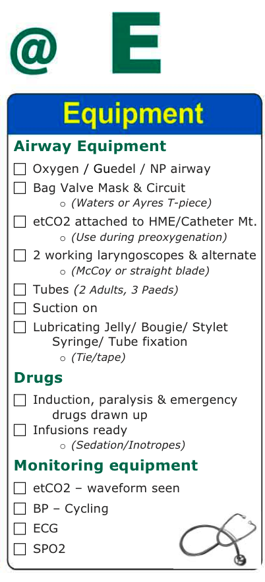
What do we do?
RSI
Preparation
Difficult airway
This lists the equipment required to perform an RSI. Use the checklist as an aide-memoire .
CICV
Anticipation

Slide 16
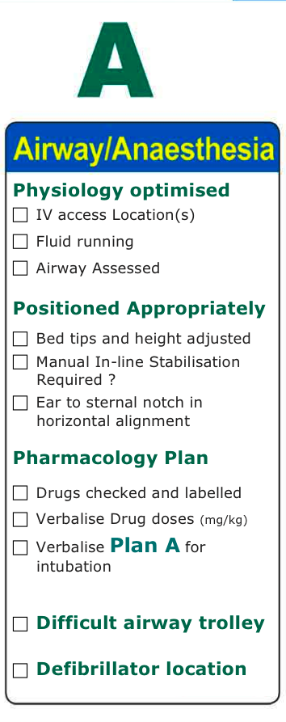
What do we do?
RSI
Preparation
Difficult airway
Use the checklist as an aide-memoire to organise the equipment, position the patient and check the drugs are drawn up and ready to go
CICV
Anticipation

Slide 17
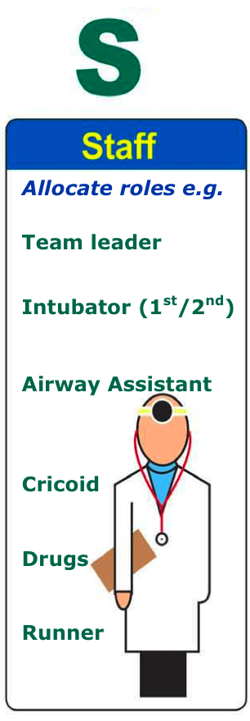
What do we do?
RSI
Preparation
Difficult airway
Ensure everyone is aware of their role during the procedure
CICV
Anticipation

Slide 18
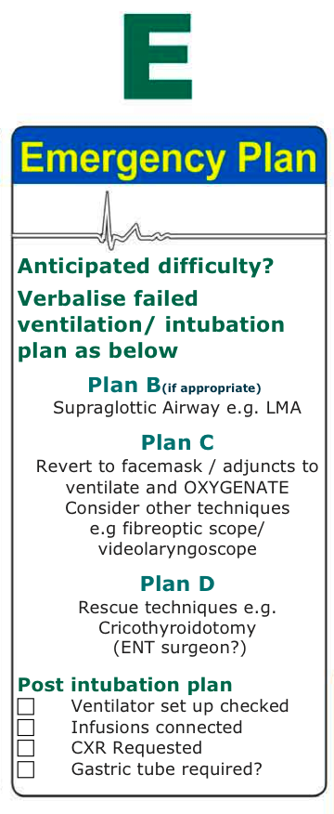
What do we do?
RSI
Preparation
Difficult airway
We will cover this in more detail in the sections on difficult airways and can’t intubate, can’t ventilate.
CICV
Anticipation

Slide 19
What do we do?
RSI
Preparation
When everything is ready, and whilst the patient is being pre-oxygenated,
the Team Leader reads the whole checklist out just prior to drug administration
Each box requires an answer, either “Yes/No” or a brief comment
For example:
Q - “2 working Laryngoscopes”
A - “Yes”
Q - “Manual In-line Stabilisation Required”
A - “Not required”
Q - “Verbalise Drug Doses and Volumes”
A - “___mg/Kg Induction agent =___mg = ___mls ”
Q - “Intubator (1st/2nd)”
A - “Dr X / Dr Y”
Difficult airway
CICV
Anticipation

Slide 20
What do we do?
RSI
Procedure
Once everyone and everything is ready the RSI is performed as follows
The patient is pre oxygenated
Cricoid pressure is applied
An iv induction agent(s) is/are given
Followed rapidly by a muscle relaxant
The patient is intubated
Tube placement is confirmed
Difficult airway
CICV
Anticipation

Slide 21
Risks
RSI
The main risk with a RSI is that we do not know we can ventilate the patient before paralysing them.
It is therefore essential that
The airway is assessed
There is a plan for a difficult/failed intubation
Also be aware that the drugs may wear off if intubation is difficult. This may be beneficial as the patient may resume spontaneous ventilation, or may be detrimental resulting in awareness of airway instrumentation and increased difficulty in intubation.
The decision as to whether further anaesthesia and/or paralysis is administered is challenging
Difficult airway
CICV
Anticipation

Slide 22
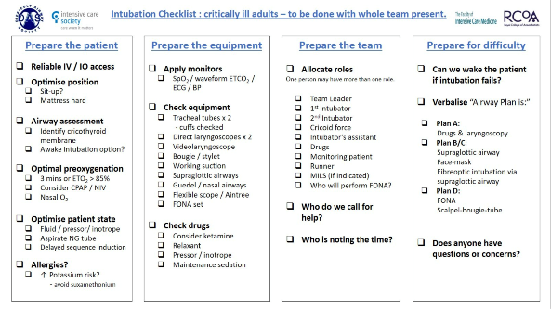
Note
RSI
The B@EASE checklist is widely used in ICUs across the Greater Manchester region. However the Difficult Airway Society (DAS) recently released its own check list. The principles of the DAS checklist are very similar to B@EASE and it may be used in some units you work in. What is important is that a check list is used.
Difficult airway
CICV
Anticipation

Slide 23
Conclusion
RSI
You should now know what a RSI is and how it is performed
Difficult airway
CICV
Anticipation

Slide 24
Preoxygenation
RSI
This is to allow as much time as possible to perform the intubation before the patient becomes hypoxic
Use a tight-fitting mask
High flow oxygen
For 3 minutes (ETO2 should be >90%) if possible, or 5 vital capacity breaths is an alternative if limited time available
Note: if any air is entrained the preoxygenation should be started again
Difficult airway
CICV
Anticipation

Slide 25
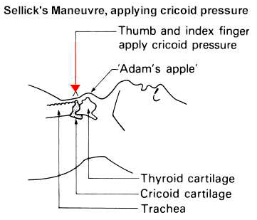
Cricoid Pressure
RSI
The aim of cricoid pressure is to occlude the oesophagus and hence reduce the risk of regurgitation and aspiration
It should be performed by a trained assistant.
Cricoid pressure is only released when asked to by the person performing the intubation.
Difficult airway
Pressure is applied to the cricoid cartilage of 10N initially, increased to 30N once the patient is unconscious
CICV
Anticipation
Image credit: http://airwayeducation.homestead.com/airway4.jpg

Slide 26
Induction Agents
RSI
An induction agent is used to provide general anaesthesia
Classically thiopentone is used
However you will often see other agents used instead including propofol, ketamine and less frequently etomidate
An opiate may be given either before or after the intubation to help obtund the hypertensive response to laryngoscopy
(More information on each of the drugs can be found by clicking on them. This is only required if you are responsible for administering them.)
Difficult airway
CICV
Anticipation

Slide 27
Thiopentone
RSI
Dose: 4-6mg/kg iv
Effect: Hypnotic
Advantages: Rapid predictable onset (one arm-brain circulation time)
Disadvantages: Hypotension, allergy, intra-arterial injection causes tissue necrosis, can trigger porphyria crises
Other: has to be reconstituted in water prior to use
Difficult airway
CICV
Anticipation

Slide 28
Propofol
RSI
Dose: 1.5-2.5 mg/kg
Effect: Hypnotic
Advantages: suppresses laryngeal reflexes, anti-emetic
Disadvantages: Slower onset than thiopentone (and slower offset), CVS instability (vasodilatation and cardiac suppression)
Other: Can cause epileptiform movements
Difficult airway
CICV
Anticipation

Slide 29
Muscle Relaxants
RSI
A muscle relaxant is given to paralyse the patient
Classically suxamethonium is given
However rocuronium is also now commonly used
(More information on each of the drugs can be found by clicking on them. This is only required if you are responsible for prescribing them.)
Difficult airway
CICV
Anticipation

Slide 30
Suxamethonium
RSI
Dose: 1.0 – 2.0 mg/kg iv
Effect: Profound neuromuscular blockade
Advantages: Rapid onset (within 60secs) and offset (3-5mins)
Disadvantages: Lots of side effects including
Hyperkalaemia
Bradycardia
Suxamethonium apnoea (i.e. prolonged effect ranging from 30 mins to several hours)
Raised intraocular and intracranial pressure (transient)
Malignant hyperthermia
Allergy
Other: Patient fasciculates before relaxing
Difficult airway
CICV
Anticipation

Slide 31
Rocuronium
RSI
Dose: 0.6 – 1.2 mg/kg
Effect: neuromuscular blockade (non-depolarizing)
Advantages: Can be rapidly reversed with sugammadex, does not cause significant cardiovascular instability or electrolyte disturbances
Disadvantages: Longer onset than sux (60 seconds) and offset (dependant on dose administered)
Other: Prolonged effect in renal faliure
Difficult airway
CICV
Anticipation

Slide 32
Confirming tube placement
RSI
This is done by a combination of watching the tube pass through the vocal cords, observing the chest rising and falling and most importantly with a sustained capnography trace.
It is important to then check that the tube is in the correct position and has not gone down into the right or left main bronchus (most commonly the right main bronchus). This is done by auscultating on both sides of the chest and checking the length of the tube at the teeth (roughly 19-21cm for women, 21-23cm for men)
Once the placement of the tube is confirmed it should be secured in position and a check x ray taken
Difficult airway
CICV
Anticipation

Slide 33
Difficult airway
RSI
Difficult airway
CICV
On-line Tutorial
Anticipation

Slide 34
Summary
RSI
This section covers how to manage a difficult airway.
Learning Outcomes
Know how to prepare for a potentially difficult airway
Have reviewed and understood the difficult airway algorithms
Difficult airway
CICV
Anticipation

Slide 35
Contents
RSI
Definition
Airway management in ICU patients
How to prepare for the difficult airway
Use of the Difficult Airway Society algorithms
Suggested equipment
Difficult airway
CICV
Anticipation

Slide 36
Definition
RSI
A clinical situation in which a conventionally trained anaesthetist experiences difficulty with mask ventilation, tracheal intubation (using Macintosh blade), or both
Difficulty with LMA insertion
Consider EVERY intubation on ICU to be difficult until proven otherwise!
Difficult airway
CICV
Anticipation

Slide 37
Airway management in ICU patients
RSI
In March 2011 the 4th National Audit program found that a disproportionate number of reported airway events occurred on ICUs
Why?
Multifactorial
More sick patients; less time to prepare correctly, less time to employ secondary strategies, more stress on team.
Distorted anatomy; airway oedema more common, previously intubated, surgery to airway, tracheostomy.
Less frequent event compared to theatre
Staff less familiar with difficult airway equipment
Patients not optimally positioned, trolleys vs beds
Difficult airway
CICV
Anticipation

Slide 38
Preparing for a difficult intubation
RSI
Induction of anaesthesia and intubation of a critically ill patient is challenging
A checklist should be used prior to any airway procedure on the ICU (see section on RSI)
The Emergency Plan should be discussed within the team before commencing induction of anaesthesia
The decision regarding whether the patient should be allowed to wake up in the event of a failed intubation should be discussed before starting.
Difficult airway
CICV
Anticipation

Slide 39
Preparing for a difficult intubation
RSI
The Emergency Plan requires consideration of what to do if the first plan fails, i.e a plan B, C and D
The Difficult Airway Society have an algorithm which helps guide the team in the event of a failed intubation
Difficult Airway Trolleys should be divided into Plan A, Plan B, Plan C and Plan D, with each ‘plan’ occupying a drawer in the trolley. The equipment required for each plan should be kept within the drawer
Difficult airway
CICV
Anticipation

Slide 40
Preparing for a difficult intubation
RSI
Algorithms
The next slide show the DAS flowchart for intubation in critical ill patients
This is subsequently explained in detail
The DAS guidelines are extremely useful when constructing the Plans A-D for the intubation of a critically ill patient
Difficult airway
CICV
Anticipation

Slide 41
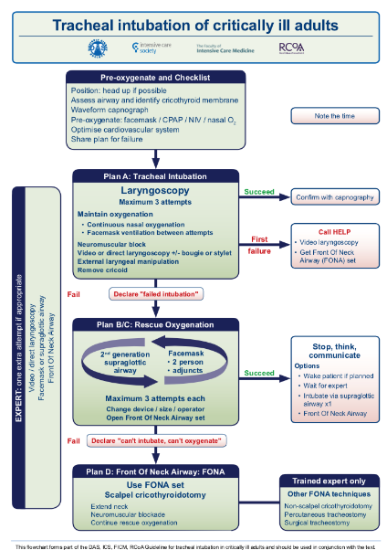
RSI
The DAS algorithm for intubation of critically ill adults is shown here
Plans A and B are concerned with securing the airway, but failure to oxygenate means you should move to Plan C
Plan C suggests waking the patient if you are able to oxygenate, however this may not be an option for a critically ill patient
Plan D involves rescue strategies in the event of a can’t intubate, can’t ventilate situation
Difficult airway
CICV
Anticipation

Slide 42
Plan A
Direct laryngoscopy
No more than 3 attempts at intubation should be made
If after 3 attempts intubation has failed – move to plan B/C
RSI
Difficult airway
CICV
Anticipation

Slide 43
Plan B/C
The aim is to oxygenate the patient
If it is not safe to wake the patient then oxygenation should be maintained by face mask or LMA until a definitive airway is inserted. This is likely to require input from a more senior colleague
If you are unable to oxygenate – move to plan D
RSI
Difficult airway
CICV
Anticipation

Slide 44
Plan D
See section on can’t intubate can’t ventilate situations
RSI
Difficult airway
CICV
Anticipation

Slide 45
Preparing for a Difficult Intubation
RSI
The team should decide whether it is appropriate to wake the patient before commencing the RSI
Difficult airway
CICV
Anticipation

Slide 46
Preparing for a Difficult Intubation
RSI
Equipment
Knowledge of both the content and layout of the difficult airway trolley is paramount
An example stock list for a difficult airway trolley can be found here
Difficult airway
CICV
Anticipation

Slide 47
Conclusion
RSI
You should now
Understand what a difficult airway situation is
Know how to use the difficult airway society algorithms
Be aware of the layout of a standard difficult airway trolley
Difficult airway
CICV
Anticipation

Slide 48
Preparing for a Difficult Intubation
RSI
Equipment
Difficult airway
CICV
Anticipation

Slide 49
Can’t intubate, Can’t ventilate
RSI
Difficult airway
CICV
On-line Tutorial
Anticipation

Slide 50
Summary
RSI
This section covers what happens when, following induction, you cannot intubate or ventilate the patient.
Learning Outcomes
Know what a can’t intubate, can’t ventilate situation is
Know what is involved in the can’t intubate, can’t ventilate algorithm
Difficult airway
CICV
Anticipation

Slide 51
Contents
RSI
Definition
Management
Difficult airway
CICV
Anticipation

Slide 52
Definition
RSI
Having performed a RSI you are unable to intubate the patient. If your rescue strategies also fail to oxygenate the patient then you have a can’t intubate, can’t ventilate scenario
Without oxygen delivery by some means the patient will rapidly become hypoxic and often the option of allowing the patient to wake and spontaneously breathe may not be available in the critically ill ICU patient
Difficult airway
CICV
Anticipation

Slide 53
Management
RSI
In the event of a can’t intubate, cant ventilate situation a “front of neck airway” FONA is performed
The next side shows the Difficult Airway Society (DAS) guidelines for the management of a can’t intubate, can’t ventilate situation – Plan D.
Difficult airway
CICV
Anticipation

Slide 54
RSI
Difficult airway
CICV
Anticipation

Slide 55
Management
RSI
The important point in a can’t intubate situation is not to delay. If plans A, B and C have failed you must move onto plan D.
It is now recommended by DAS that a scalpel cricothyroidotomy is performed.
A demonstration of the scalpel cricothyroidotomy technique can be seen at the following link
https://www.youtube.com/watch?v=DuLPCAM6ZhA
Difficult airway
CICV
Anticipation

Slide 56
Conclusion
RSI
You should now know what a can’t intubate, can’t ventilate situation is and how it should be managed according to the DAS guidelines
Difficult airway
CICV
Anticipation

Slide 57
Anticipating a difficult airway
RSI
Difficult airway
CICV
On-line Tutorial
Anticipation

Slide 58
Summary
RSI
This section covers how to assess a patients airway and anticipate difficulties before they arise
Learning Outcomes
Know important aspects of history, examination and investigation which may help predict a difficult airway
Know different techniques for assessing a patients airway
Understand the limitations in airway assessment
Difficult airway
CICV
Anticipation

Slide 59
Contents
RSI
How to assess the airway
History
Examination
Investigation
Is assessment any good?
Difficult airway
CICV
Anticipation

Slide 60
How to assess the airway
RSI
It is sometimes possible to anticipate that a patient may be difficult to intubate.
Knowing this may alter your plans for intubation
When reviewing a patient to assess their airway it is important to take a detailed history, perform an appropriate examination and review any relevant investigations they have had.
Difficult airway
CICV
Anticipation

Slide 61
History
RSI
The following may alert you to a possible problem with the airway
Difficult airway
Symptoms
Voice change
Dysphagia
Positional effect on breathing
Stridor
Congenital
eg Pierre Robin
Acquired
Neoplastic: tumour, surgery, radiotherapy
Infection: dental abscess
Endocrine: thyroid goitre, acromegaly, diabetes
Trauma: laryngeal, neck
Inflammatory/ connective tissue: Rheumatoid arthritis, ankylosing spondylitis
Previous difficult airway
Alert bracelet, letter
Patient notes - anaesthetic charts
Medical history
Other sources of information
CICV
Anticipation

Slide 62
Examination
RSI
Does the patient have
Buck teeth
Missing teeth
Receding jaw
Small mouth
Large tongue
Bull neck
Obesity
Beard
All of these may make intubation more difficult
Difficult airway
CICV
Anticipation

Slide 63
Examination
RSI
There are more specific examinations which can be performed to help identify a patient with a difficult airway. These include
Mallampati Test
Thyromental Distance (Patil)
Mandibular Subluxation (Calder)
Inter Incisor Gap
Other tests
Performing more than one of the tests can reduce the number of false positives and false negatives
Difficult airway
CICV
Anticipation

Slide 64
Investigations
RSI
A patient may have had relevant investigations. These could either be for their present condition or done in the past for some other reason. If available they should be reviewed and may alert you to a possible problem.
For example
Plain X-ray of the neck
Scans including CT or MRI of the neck
Nasendoscopy
These tests can be helpful identifying patients with abnormal anatomy who are likely to be difficult, but do not guarantee an easy intubation
Difficult airway
CICV
Anticipation

Slide 65
Is assessment any good?
RSI
There will always be false positives and false negatives when assessing the airway and there is significant inter-observer variability. A positive test however does increase the chance of difficulty.
Although difficult airways will be missed, each one that is correctly identified reduces the risk.
It allows the choice of the safest technique to be made in advance.
It may affect where and by whom the procedure is performed.
The correct back up strategy can be in place (this may include an anesthetic consultant or a ENT surgeon to be present)
And if it’s a false alarm? Its not a problem, the patient will still have been safely intubated
Difficult airway
CICV
Anticipation

Slide 66
Conclusion
RSI
You should now know how you can assess a patient’s airway to attempt to anticipate those that may be difficult
In a critical care setting a detailed assessment of the patient’s airway may not be possible. The patient may have a reduced level of consciousness and therefore not cooperate with examination and the time frame for intubation is more time critical.
Difficult airway
CICV
Anticipation

Slide 67
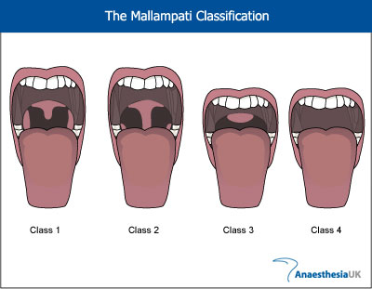
Mallampati Test
RSI
Size of tongue in relation to oral cavity
Face to face
Open as wide as possible
Stick tongue out
Dont say “Aah”
3, 4 = difficulty
Difficult airway
CICV
Anticipation

Slide 68
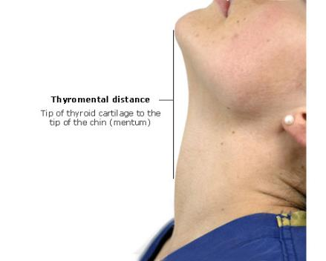
Thyromental Distance (Patil)
RSI
Head back as far possible
Mouth closed
Less than 6.5 cm = difficulty
4 fingers
Difficult airway
CICV
Anticipation

Slide 69
Mandibular Subluxation (Calder)
RSI
Push bottom teeth out in front of top teeth
Class A = bottom teeth in front of top teeth
Class B = teeth level
Class C = bottom teeth behind top teeth
B, C = difficulty
Difficult airway
CICV
Anticipation

Slide 70
Inter Incisor Gap
RSI
Normal = 5cm = 3 fingers
<3cm = difficult laryngoscopy
<2cm = difficult LMA insertion
Difficult airway
CICV
Anticipation

Slide 71
Other tests
RSI
Sternomental distance (Savva) >12.5cm
Ratio of height to Thyromental distance >23.5cm
Delikan’s test (neck movement)
Wilson’s score (scoring system of 5 variables)
Difficult airway
CICV
Anticipation

