Slide 1
SAMI
Insert date

Slide 2
Contents
Aims
Why is it important?
Practicalities

Slide 3
Aims
Improve patient safety when intubating on ICU
Develop the multidisciplinary skills required for intubation in an ICU patient
Initially to train key people across the region with the aim of creating a core of skilled people to distribute it to their own trusts
By the end of the course all candidates should be confident to undertake their role in an
emergency intubation on ICU
a difficult intubation situation on ICU
a cant ventilate situation on ICU

Slide 4
Why is it important?
Teamwork requires practice, as multi professionals rather than in individual disciplines
In an emergency you will fall back on your basic training
The first time you maybe required to this it is likely to be a life and death situation
Notes:
All of you have different back grounds and levels of experience, that’s the good bit and the hard part of the course. Some of it you may feel is too easy however ………..
That inevitably means that we will have to cover some material which many of you already know, although we hope the precourse material will negate some of the need to repeat the basics…………
Therefore you need to have had opportunity to practice the basics so they are second nature. Fortunately these events are rare this means……….. So its good to practice

Slide 5
Practicalities
Fire
Running to time
On-line post course reflection and feedback
Certificates
Notes:
Quite a tight timetable. We’d like to finish on time! Need to be at your next session and ready to start on time!
Reflection is an essential part of the course process
Certificates will be given to you once you have completed the post course reflection

Slide 6
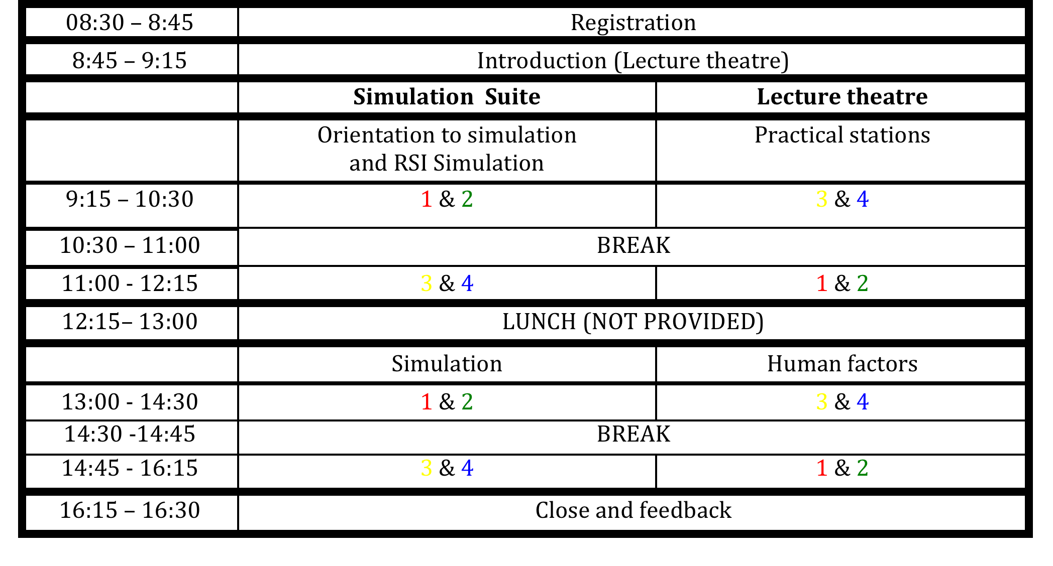
Practicalities
Notes:
Insert your own timetable

